Slide 1
Introduction to Neural Networks

Slide 2
Neural Networks
Biological Neural Networks
Artificial Neural Networks

Slide 3
Biological Neural Networks
Biological systems offer the possibility of designing intelligent systems.
- They process information in a non-conventional way.
- They do not require reference models.
- They perform successfully in the presence of uncertainty.
- Learn to perform new tasks.
- Adapt easily to changing environments

Slide 4
What is learning?
A system is said to have the ability to learn if it acquires and processes information about its performance and the surrounding environment to improve its performance.

Slide 5
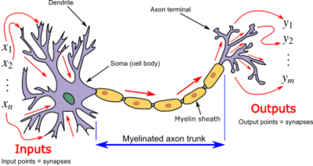
https://en.wikipedia.org/wiki/Biological_neuron_model

Slide 6
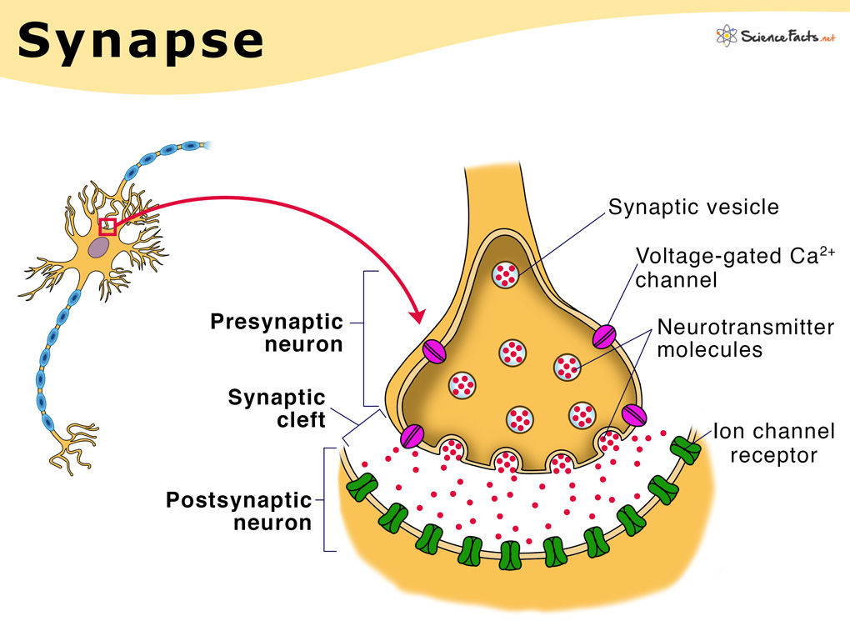
Synapses
Information transmission process
https://www.sciencefacts.net/synapse.html

Slide 7
Neural Networks
They are made up of a large number of neurons, connected in a massive way.
They make up the nervous system and the brain; human brain can contain 10¹¹ neurons and, 10¹⁵ intercom
Biological neural networks can be established as be established as groups of active neurons specializing in specialized in tasks such as: mathematical mathematical calculations, positioning and memory. nections.

Slide 8
Artificial Neural Networks
These are simplified models of biological neural biological neural networks.
They try to extract the excellent capabilities of the brain to solve certain complex problems. complex problems.
- Vision
- pattern recognition
- motor-sensory control

Slide 9
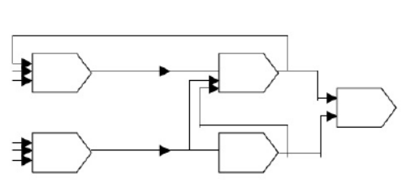

Representation of an Artificial Neural Network
Computer element

Slide 10
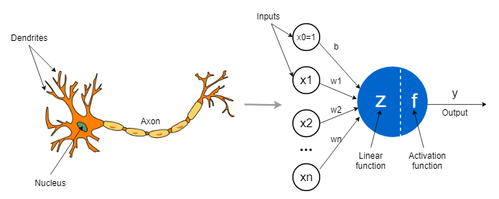
Representation of an Artificial neuron
https://towardsdatascience.com/the-concept-of-artificial-neurons-perceptrons-in-neural-networks-fab22249cbfc

Slide 11
Artificial Neural Networks
Characteristics
- Knowledge is acquired experimentally
- The weights (gains) of interconnection (synapses) are constantly varying.
Advantages
- Non-linearity
- Input-output transformation
- Adaptability
- Fault tolerance
- Uniformity in analysis and design
- Analogy with biological networks

